Slide 1

606
Chat Recommender for Restaurants:
Team B
Hafsa Chaudhry, Omar Agha Khan, Hetvi Patel, and Sarah Denlinger
Bon Appetit

Slide 2
!
Introduction
What is Yelp?
What is Goal of Project?
Notes:
More than 178 million people visit Yelp monthly (Yaramova, 2023).
Since Yelp is used by so many people, it is a goldmine for reviews. It is very useful in recommending restaurants (specifically) to users.
What is goal of the project?
The goal of this project is to create a conversational recommender system to suggest restaurants to users.
This type of recommendation system is integrated into a chatbot. The chatbot will use natural language processing (NLP) and machine learning techniques to make recommendations in a conversational manner. (such as: are you in the mood for italian? Do you want to stay local? What is your budget? Here is what i found that fits what you’re looking for)

Slide 3
Past Approaches
Using food reviews to guess food preference with 92.8% accuracy
Tourist attraction recommender system
Learn user rating patterns
What we are Doing:
Conversational recommender system
Notes:
Past approaches
A publication of Authors Elham Asani , Hamed Vahdat-Nejad, and Javad Sadri that built a context-aware recommendation system based off of a user’s food review with 92.8% accuracy. The authors used sentiment analysis to gather the user’s sentiment on certain foods and used cosine similarity to compare their preferences to the menus of restaurants in their location (Asani et al., 2021).
Authors Zahra Abbasi-Moud, Hamed Vahdat-Nejad, and Javad Sadri used there was another publication that showed semantic clustering techniques and sentiment analysis on user reviews to recommend tourist attractions to users.
Hongtao Liu, Yian Wang, Qiyao Peng, Fangzhao Wu, Lin Gan, Lin Pan, and Pengfei Jiao used deep learning methods to learn user’s rating patterns.
What we are doing
So how will we be different? We are using a conversational recommender system which allows us to receive a user’s preference in real time while intaking results through sentimental analysis and text classification models.

Slide 4
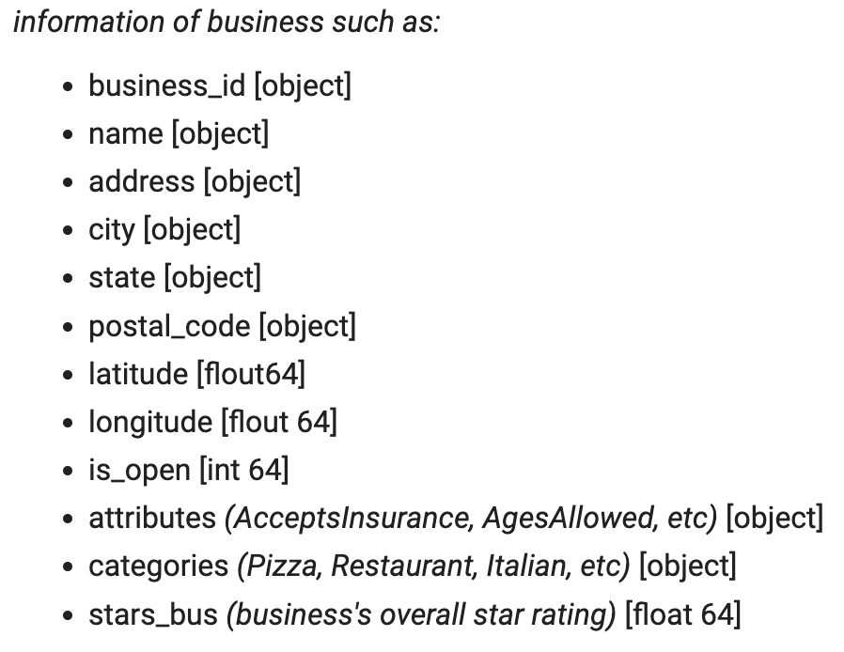
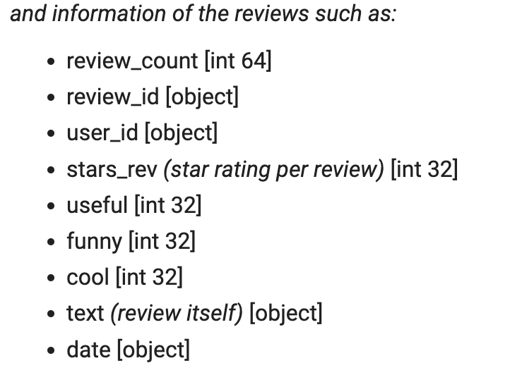
The trimmed (10%) parquet dataframe holds 415,066 rows and 21 columns
Modified from Yelp’s Open Dataset Website:
Notes:
This dataset was obtained from Yelp’s Open Dataset website
876 unique cities
26,418 unique cities

Slide 5
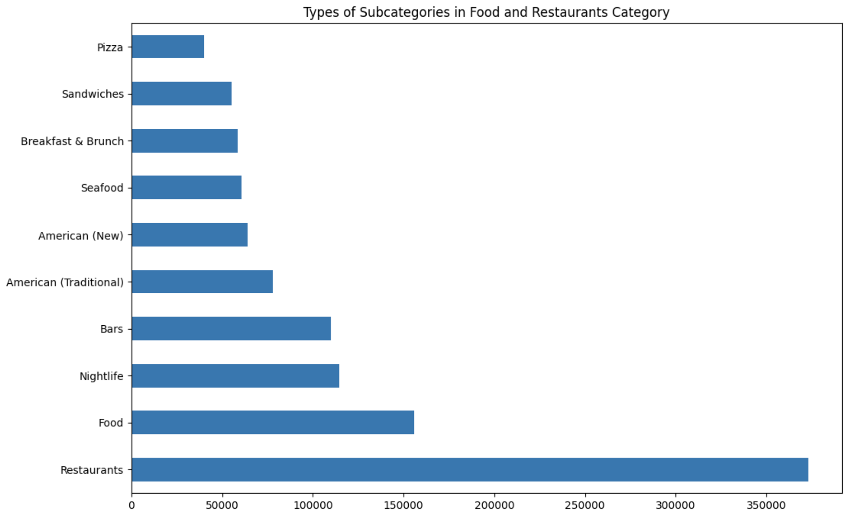
Exploratory Data
Analysis
Next few EDA slides will demonstrate:
Subcategories
Location
Rating Distributions
Top states with Businesses
Top Cities with Businesses
Notes:
(read first bit of above slide, then:) As you can see in this bar graph, we have 10 categories in the food and restaurant “hashtag” in the yelp database. “Restaurant” and “food” being the top category (need to fix this), followed by nightlife, bars, american(traditional), american(new), breakfast&brunch, sandwiches, seafood, and pizza.

Slide 6
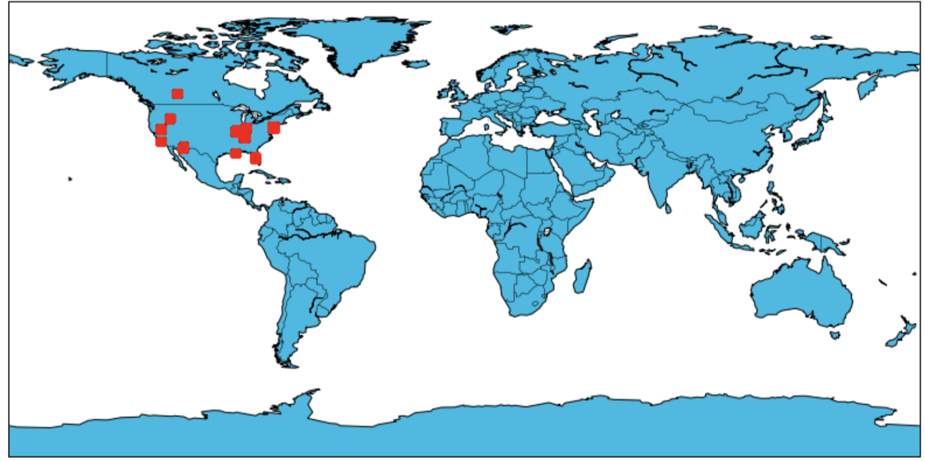
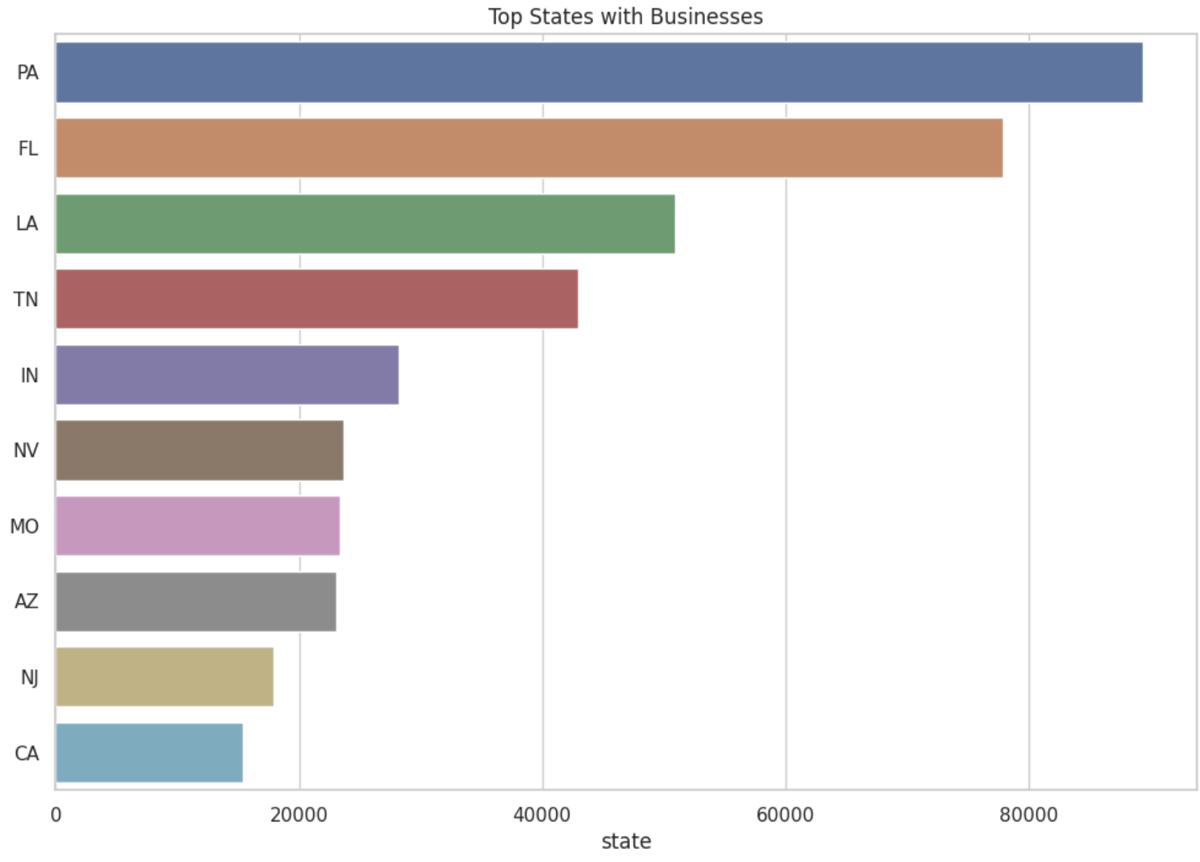
Top 10 States with Businesses
Location of Yelp reviews mostly in the US
Notes:
The next visualization is a map of the locations of the yelp reviews
And then we also have a bar graph of the top ten states with businesses
So as you can see PA has the most businesses in the dataset followed by FL and LA

Slide 7
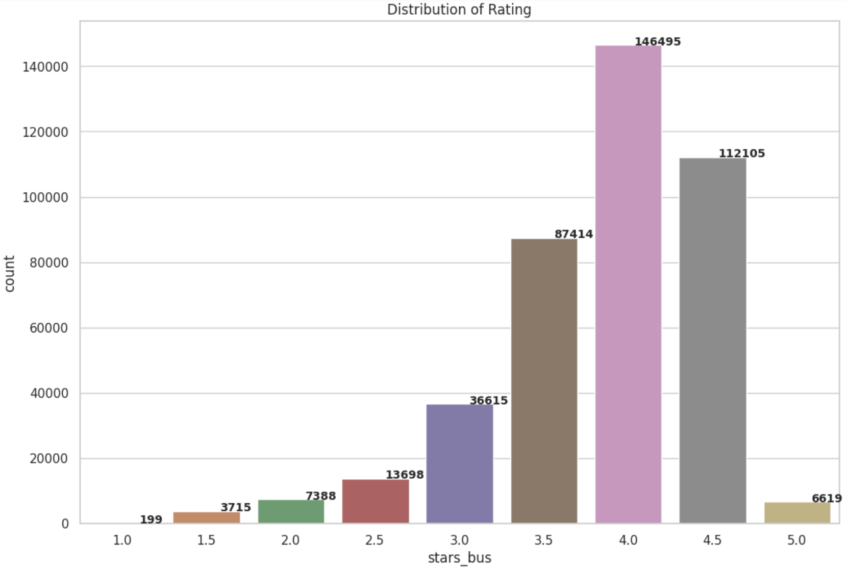
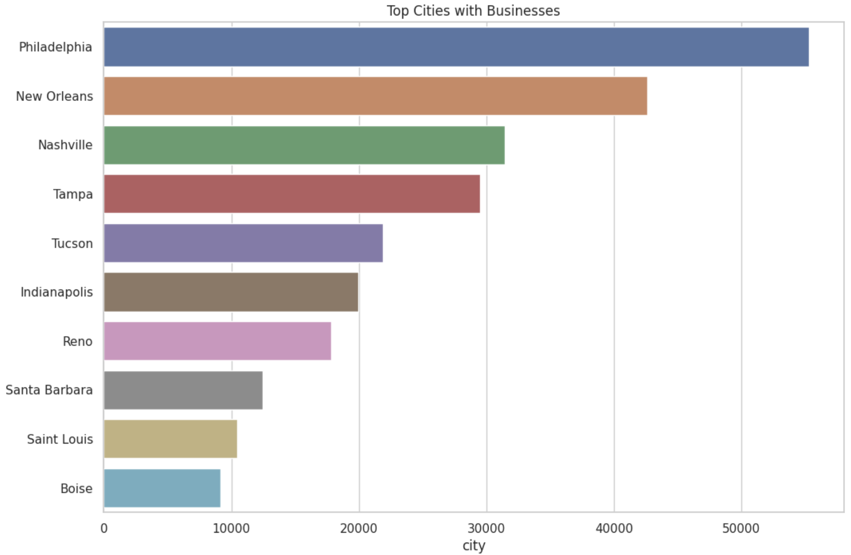
Top 10 Cities
Star Ratings from 1.0 - 5.0
Notes:
Top 10 cities are sporadically spread throughout the United States, no pattern as to where the reviews are stemming from as clusters
By far, most establishments are rated 4 stars at with 146,495 reviews
the next greatest group being 3.5 and 4.5 stars at 87,414 and 112,105 reviews respectively
We can see that this is a right skewed bell graph
Most reviews should be positive, judging by the rating

Slide 8


PipeLine: Our Approach
PipeLine: Our Approach
Sentiment Analysis
Preprocess Data
Text Classification
Recommendation Engine
Keyword Extraction
Notes:
OUr approach consists of preprocessing data, sentiment analysis, text classification, keyword extraction, and recommendation engine….
When we talk about preprocessing data we mean:
Clean and prepare the restaurant reviews
For Sentiment Analysis:
Predict Sentiment (Positive, Negative, Neutral)
For Text Classification:
Classify the reviews into categories based on their content
For Keyword Extraction:
Extract the most frequently mentioned keywords (so like if a restaurant is labeled good, it usually has that keyword mentioned within reviews: such as “oh this is good” … )
For Recommendation Engine:
use the results of the sentiment analysis, text classification, and keyword extraction to recommend restaurants to users based on their preferences and opinions.

Slide 9
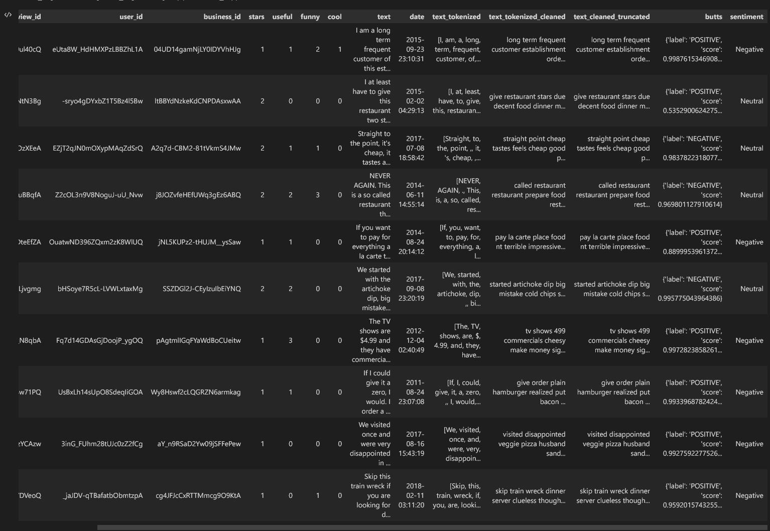
Sentiment Analysis
Used Hugging Face for sentiment analysis on Yelp reviews
Results were good but not great
Clear instances where positive reviews were labeled as negative and vice versa
Used NLTK's accuracy score to check against pretrained predictions
Results indicate need for fine-tuning the model based on our data
Continuing to refine the model for better accuracy.
Notes:
Eval metrics:
Utilized several Hugging Face pretrained models to conduct sentiment analysis on Yelp reviews
Evaluated model performance using NLTK's accuracy score against pre-trained models’ predictions
Obtained good but not great results, with some mislabeled reviews
Primary issues:
Models may not have been optimized for our specific dataset, leading to suboptimal performance
Potential issues with data quality or preprocessing may have impacted the model's ability to accurately classify reviews
Next steps:
Fine-tune the model to better align with our dataset,
Consider using data augmentation techniques to further improve model performance
Analyze the model's errors and determine if there are specific types of reviews that the model struggles to classify, which could inform further improvements to the model's architecture or training methodology

Slide 10
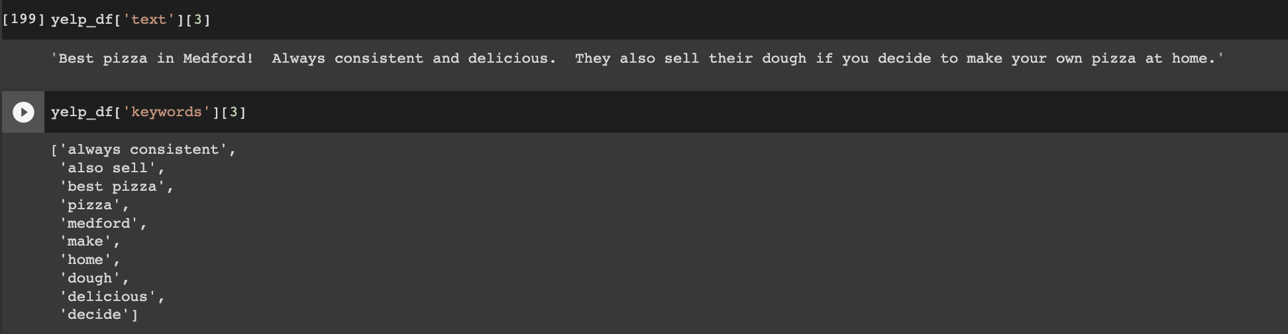
Keyword Extraction
RAKE Keyword Extractor
Vectorized using CountVectorizer
Next Steps:
Feed into recommendation model
Notes:
The Rapid Automatic Keyword Extraction, RAKE, algorithm works by using delimiters to identify candidate keywords. The keywords are given scores based on how many times the candidate word appears in the text (“Extract”, 2023).
Also cleaned up keywords, removed punctuation left over
Vectorized the keywords so that it can be fed into the recommender model
Here is an example of a review and the keywords returned

Slide 11
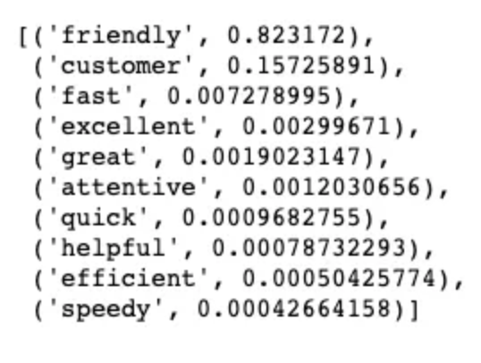
Text Classification
Notes:
Once the keywords are extracted, we can build a model (from gensim.models import Word2Vec)
see what the customers love most about the service

Slide 12
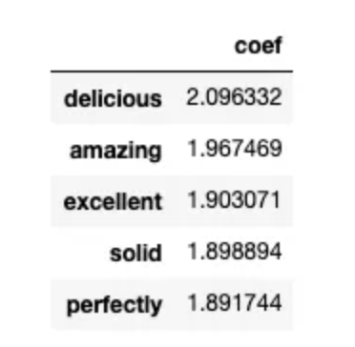
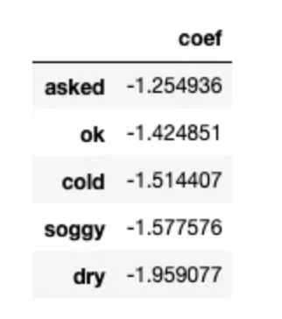
Cont.
Notes:
Most informative words for positive reviews
Most informative words for negative reviews
vectorized the reviews using BoW and split them into training set and test set. from sklearn.feature_extraction.text import CountVectorizer
from sklearn.model_selection import train_test_split)
Then make a logistic regression model(from sklearn.linear_model import LogisticRegression)

Slide 13
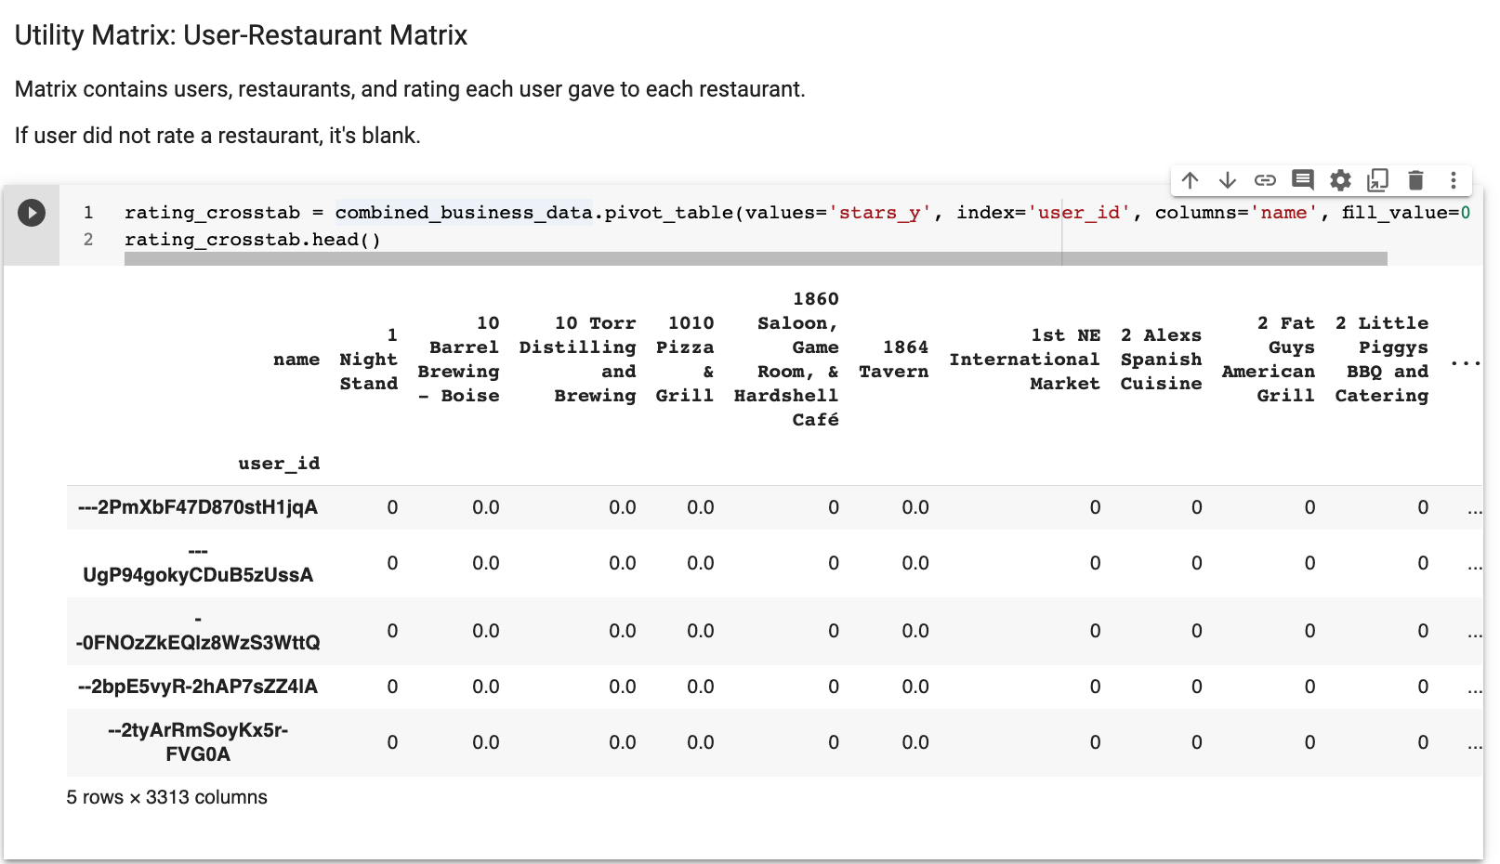
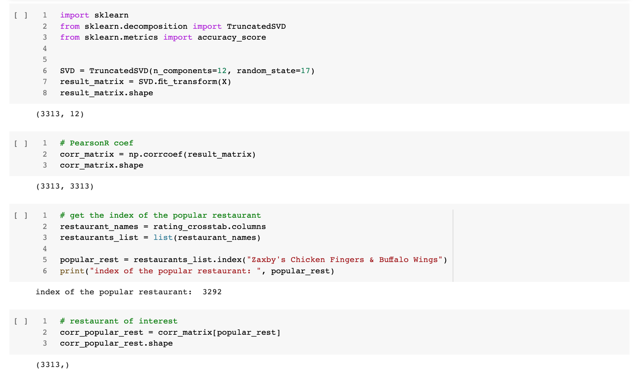
Recommender System

Slide 14
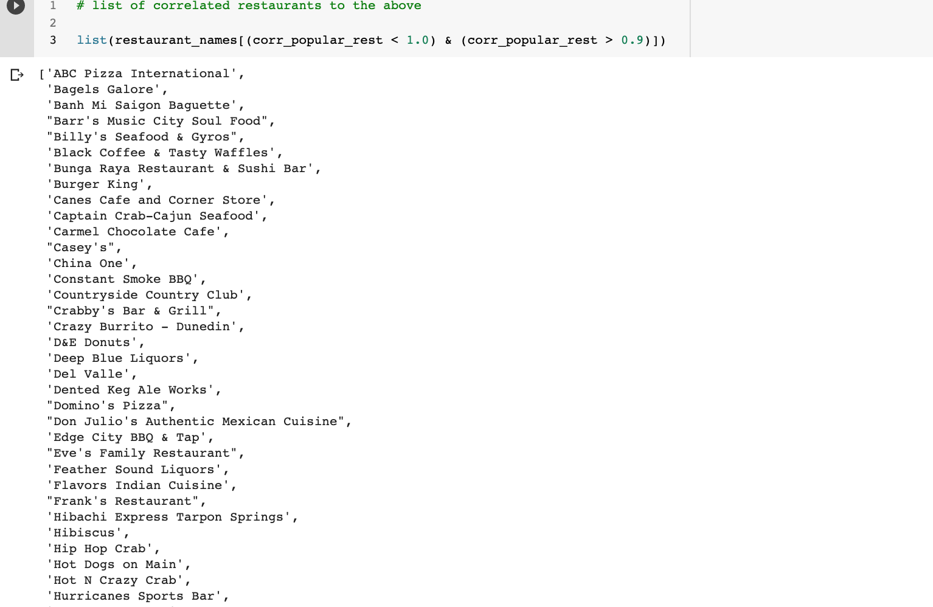
Recommender System: Cont.

Slide 15
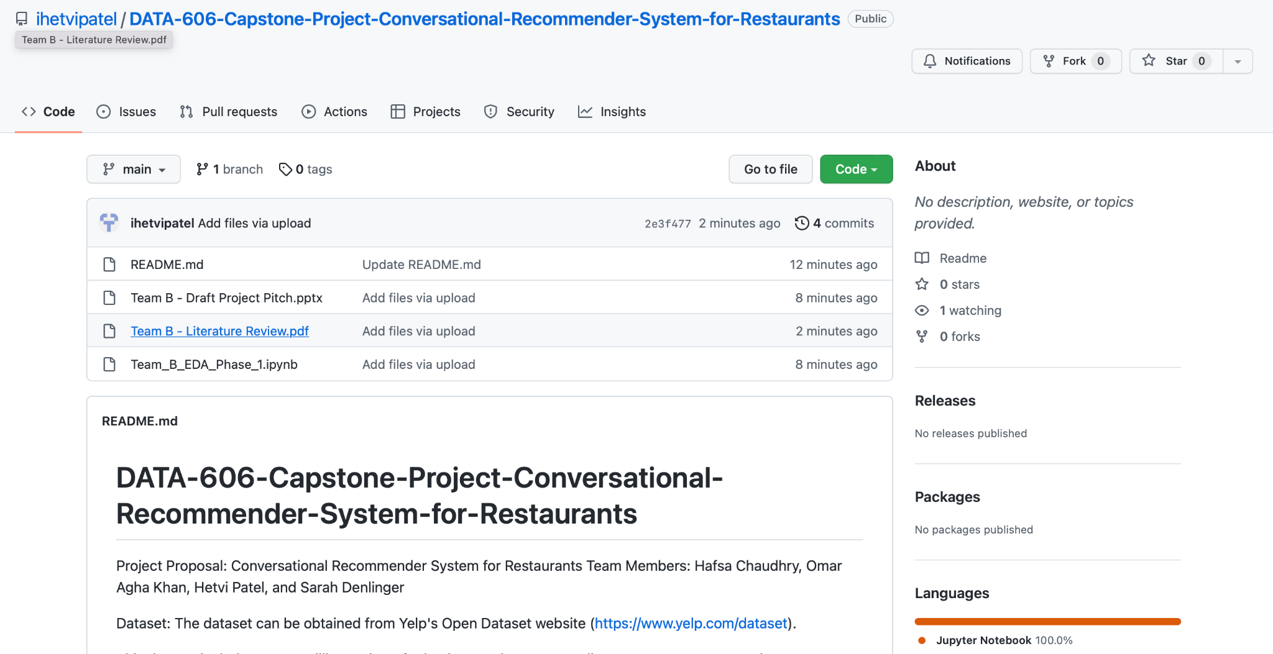
GitHub Link - https://github.com/ihetvipatel/DATA-606-Capstone-Project-Conversational-Recommender-System-for-Restaurants
Notes:
This is our github link, has all our stuff on it

Slide 16
Chatbot Integration
1. Create Chatbot to rely on results. Interacts with user: outputs questions, collects user input
2. Collect user’s preferences
“Are you in the mood for Italian food?”
“Do you prefer fine dining or casual dining?”
3. Suggest restaurants to match preferences
Distance from user’s location
Reviews
Cuisine
4. Provide additional information
Rating
Menu
Hours of operation
Notes:
We first have to create a chatbot that can engage in natural language conversations with users… and make recommendations based on the results of our analysis.
The chatbot can ask questions to gather information about the user's preferences and use that information to make recommendations.
For example, the chatbot might ask questions like "Are you in the mood for Italian food?" or "Do you prefer fine dining or casual dining?"
Based on the user's answers, the chatbot can use the recommendation engine to suggest restaurants that match the user's preferences.
User preferences include distance from user’s location, reviews, and cuisine.
The chatbot can then provide the user with additional information about the recommended restaurants, such as their restaurant rating, locations, menus, and hours of operation.

Slide 17
Next Steps
Next Steps
Integrate 3 models (sentiment analysis, text classification, and keyword extraction) into recommender system
Look into Web API for chatbot and have it integrate with the rest of the models (sentiment analysis, text classification, and recommendation engine)
For accessibility to the general public
Notes:
Next steps : read as is

Slide 18
References
Yaramova, S. (2023, January 30). 25 curious yelp statistics to show how big it is in 2023. Techjury. Retrieved February 20, 2023, from https://techjury.net/blog/yelp-statistics/#gref
Asani, E., Vahdat-Nejad, H., &amp; Sadri, J. (2021). Restaurant Recommender System based on sentiment analysis. Machine Learning with Applications, 6(100114). https://doi.org/10.1016/j.mlwa.2021.100114
Abbasi-Moud, Z., Vahdat-Nejad, H., & Sadri, J. (2021). Tourism recommendation system based on semantic clustering and sentiment analysis. Expert Systems with Applications, 167(114324). https://doi.org/10.1016/j.eswa.2020.114324
Liu, H., Wang, Y., Peng, Q., Wu, F., Gan, L., Pan, L., & Jiao, P. (2020). Hybrid neural recommendation with joint deep representation learning of ratings and reviews. Neurocomputing, 374, 77–85. https://doi.org/10.1016/j.neucom.2019.09.052
Extract Keywords from Text Data Using RAKE. MATLAB &amp; Simulink. (2023). Retrieved April 10, 2023, from https://www.mathworks.com/help/textanalytics/ug/extract-keywords-from-documents-using-rake.html
Text Mining and Sentiment Analysis for Yelp Reviews of A Burger Chain
https://towardsdatascience.com/text-mining-and-sentiment-analysis-for-yelp-reviews-of-a-burger-chain-6d3bcfcab17b
Notes:
References and DONE

